Slide 1
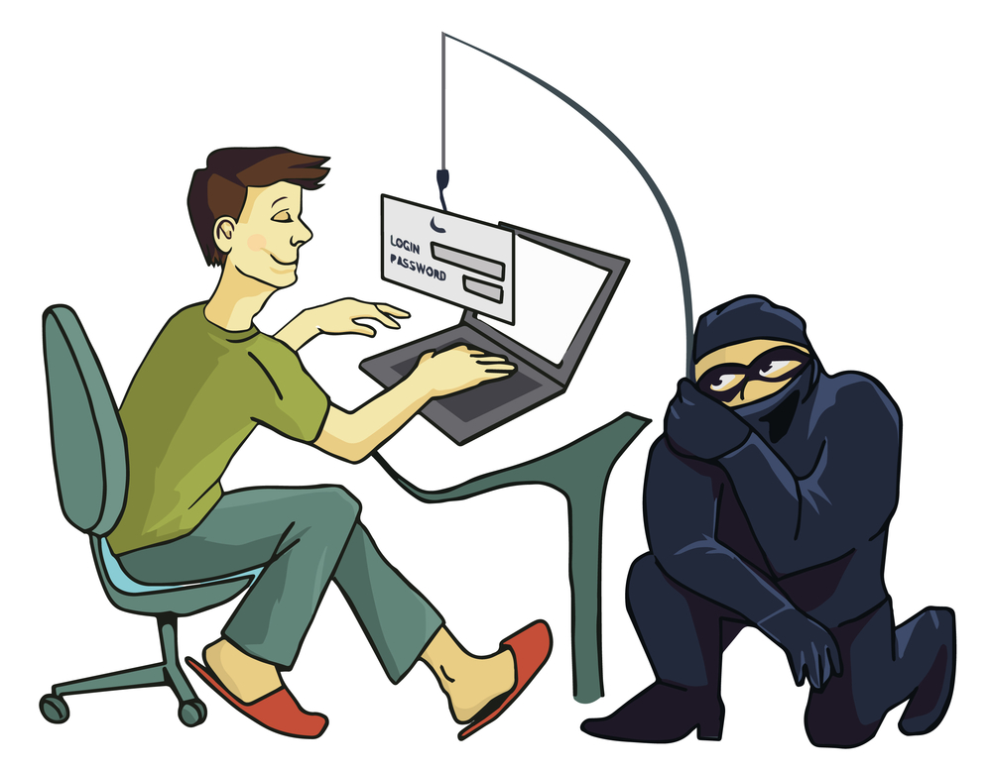
Familiarize yourself with phishing attacks
HR, Marketing, and Card Services identified as most at risk
This Photo by Unknown Author is licensed under CC BY-SA-NC

Slide 2
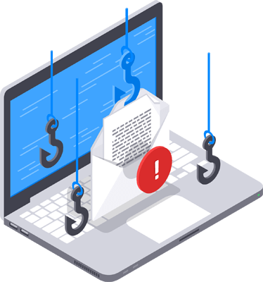
What is phishing?
Phishing = fake emails pretending to be trusted sources to steal info
Urgent password reset requests
Too-good-to-be-true offers
This Photo by Unknown Author is licensed under CC BY-SA-NC

Slide 3
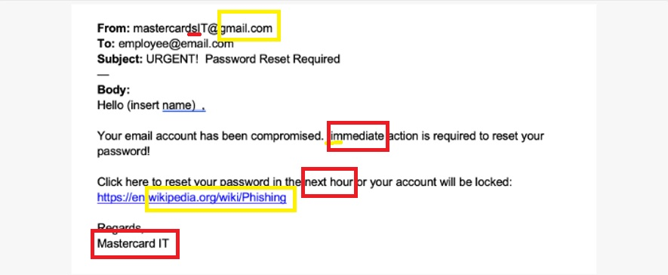

Learn to spot phishing emails
Fake 🚨- HR fell for 75% of these!
This Photo by Unknown Author is licensed under CC BY-SA

Slide 4

How do we stop getting phished?
Hover before you click
Check the sender’s email address
Don’t panic at “URGENT” scare tactics
Report suspicious emails to the IT Security Team

